Slide 1
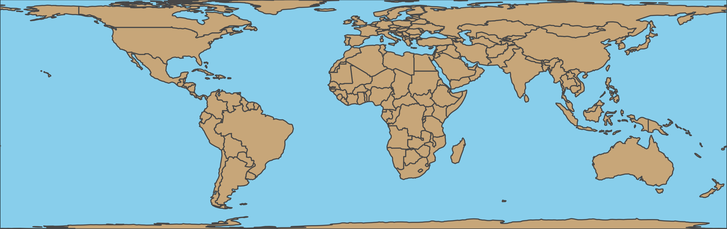
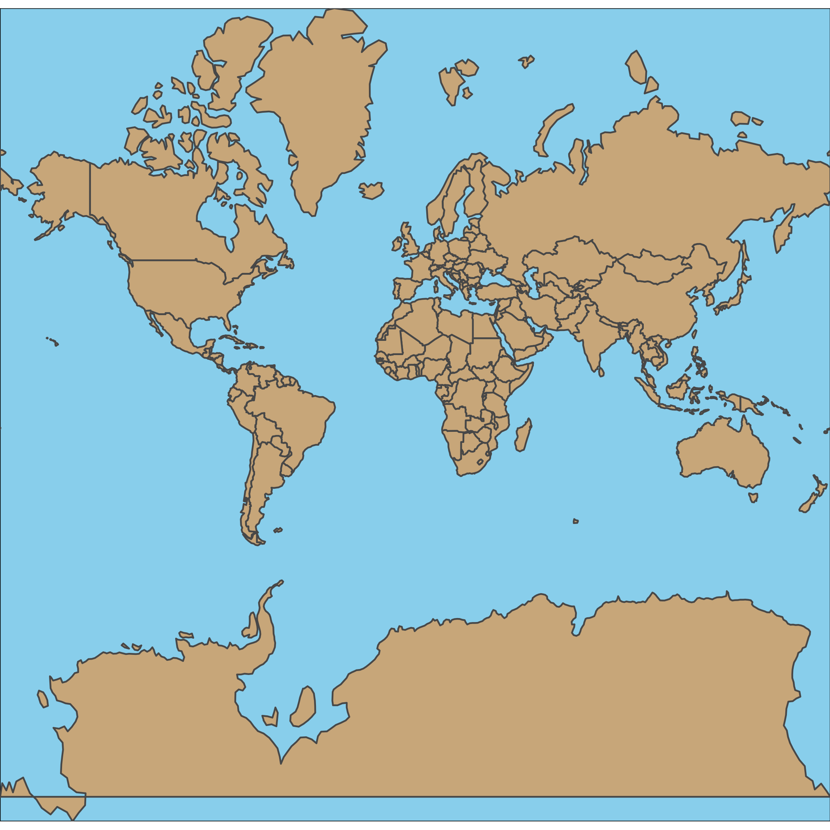
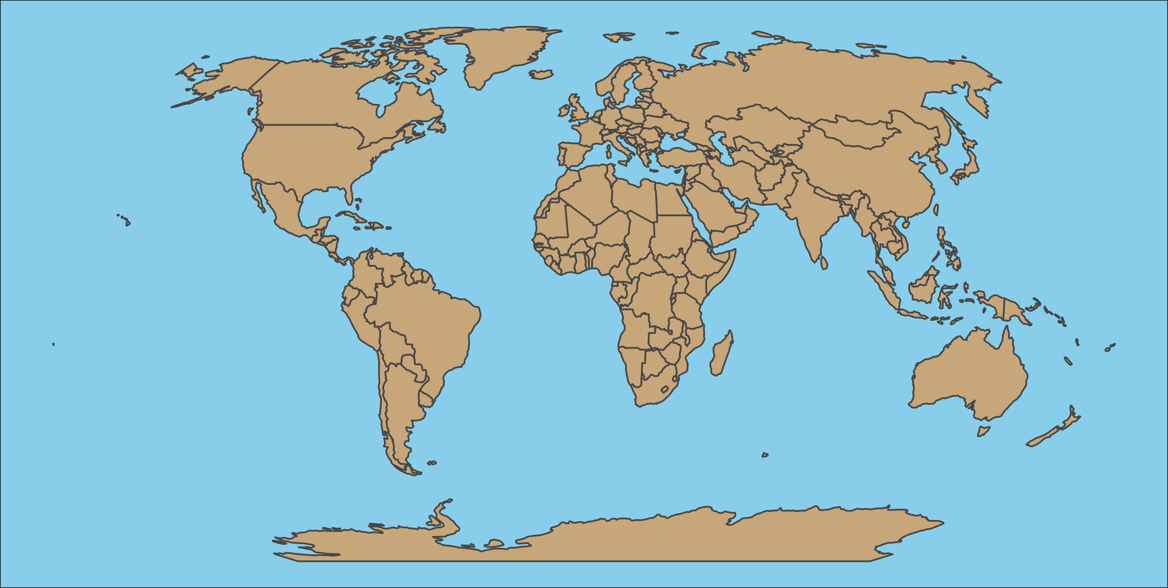

Slide 2
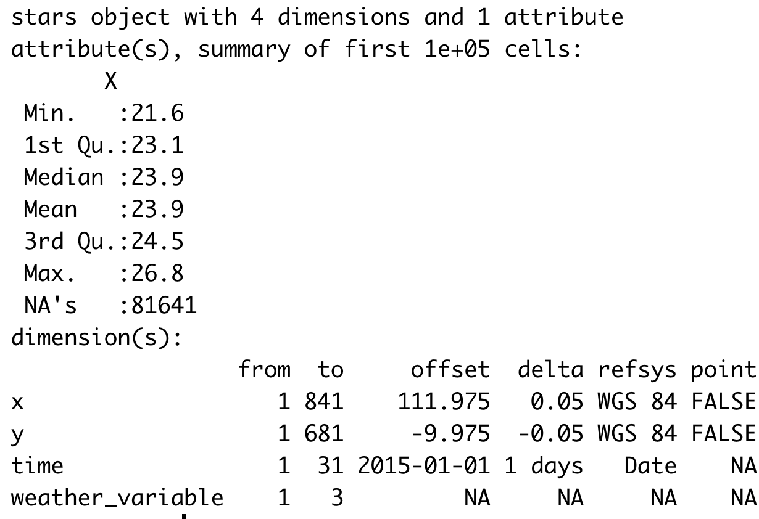

Slide 3
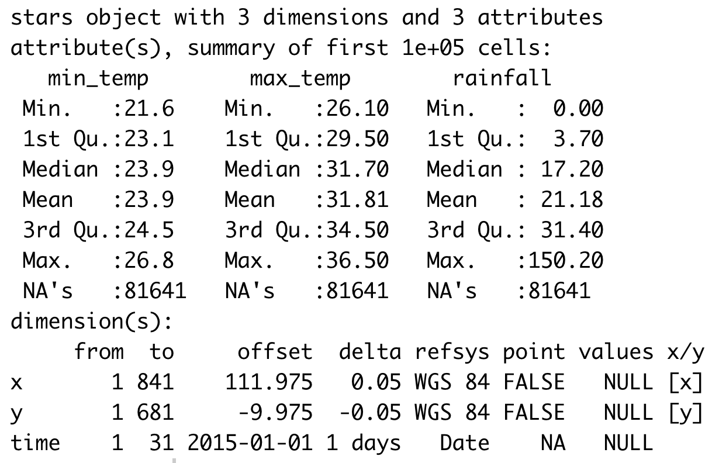

Slide 4


Slide 5
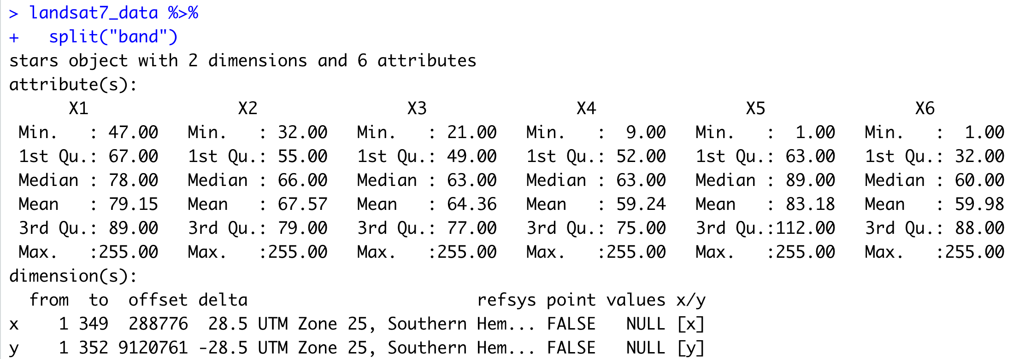

Slide 6
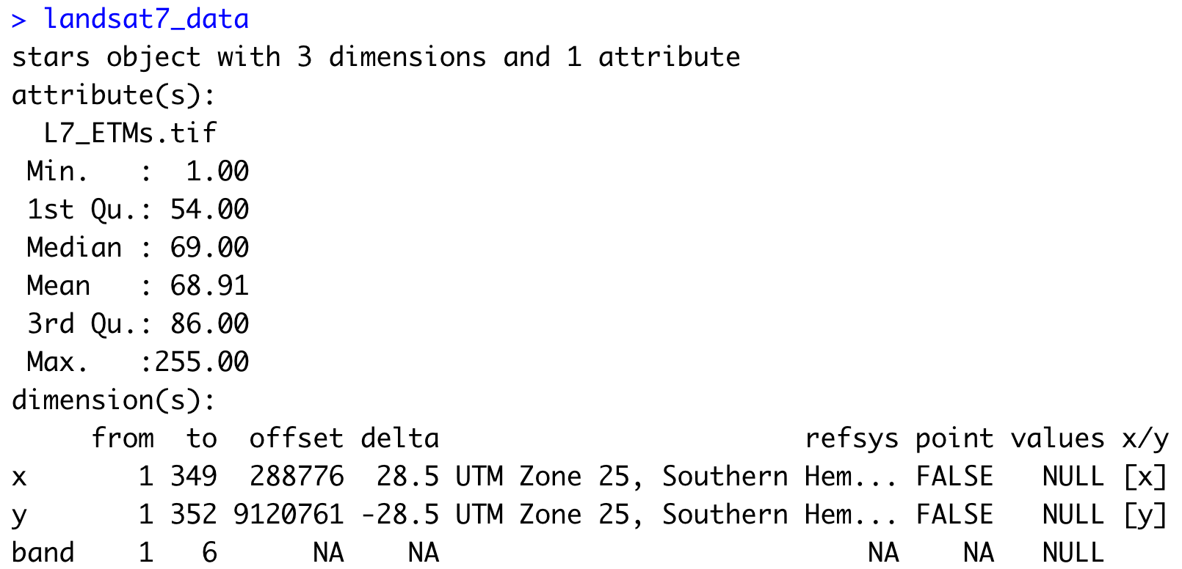

Slide 8
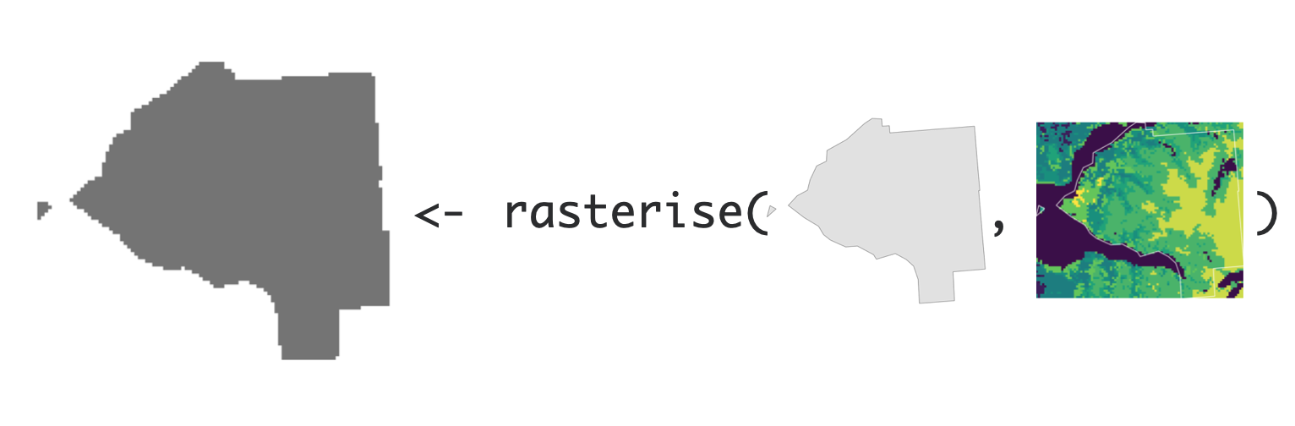
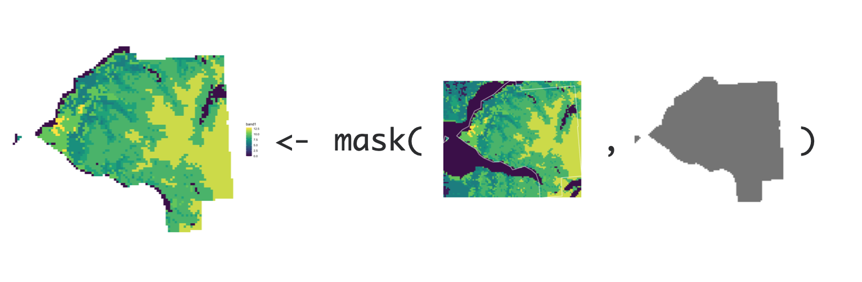

Slide 10



Slide 11


Slide 12








Slide 13
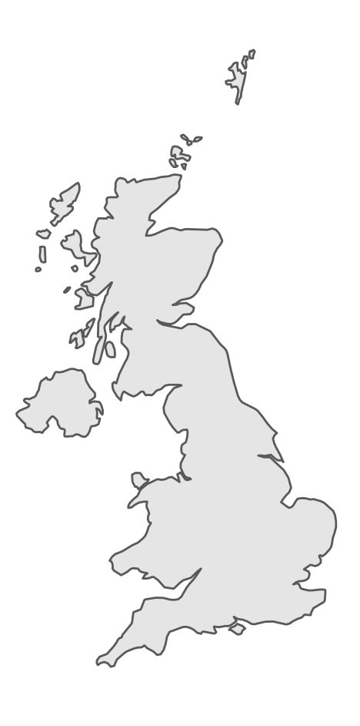
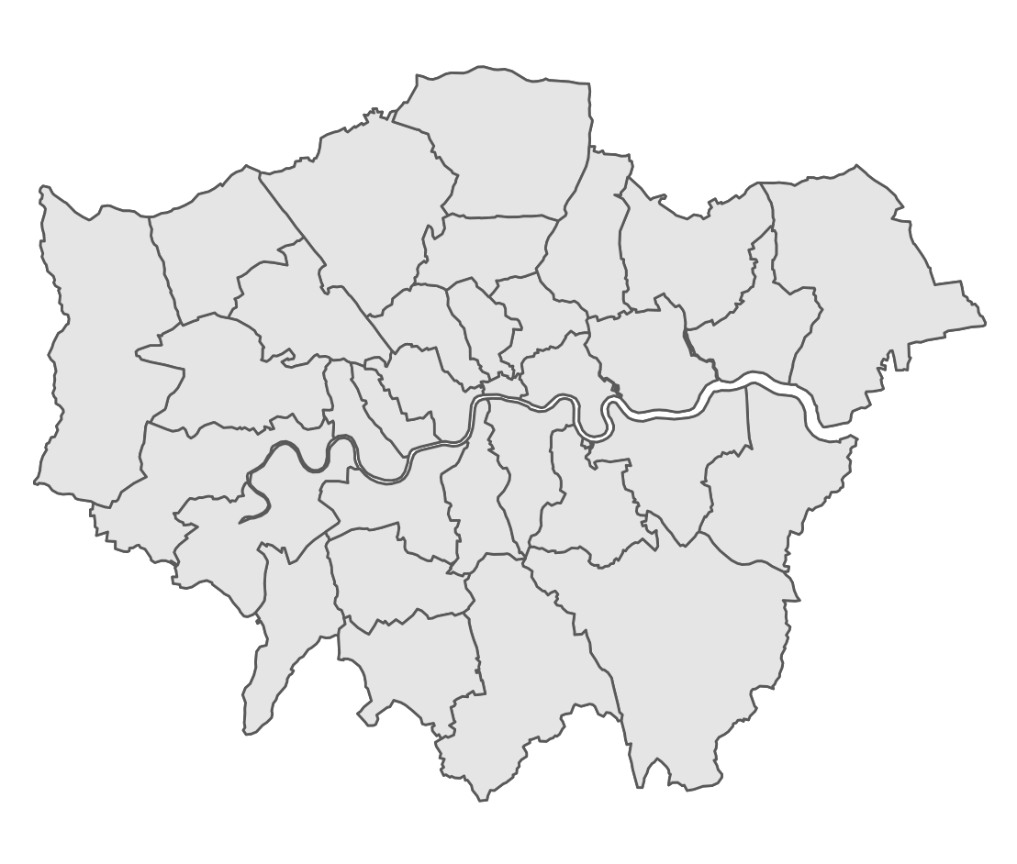
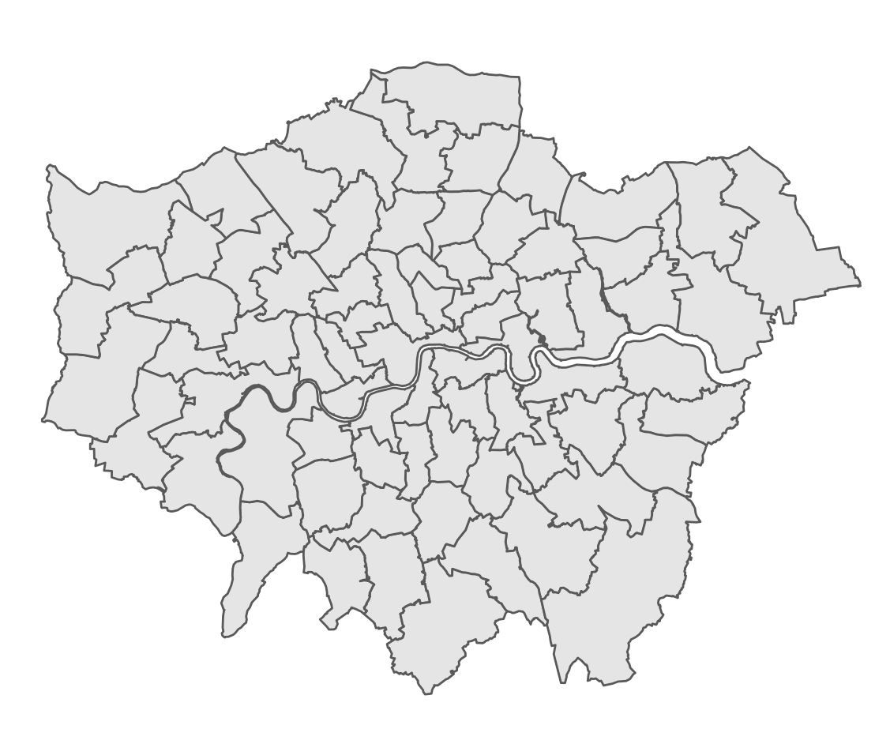
Country borders
Administrative Divisions
Other subunits
(local authorities)
(constituencies)

Slide 14
Country borders
Administrative Divisions
Other subunits
(local authorities)
(constituencies)

Slide 15
Country borders
Administrative Divisions
Other subunits
(local authorities)
(constituencies)

Slide 16
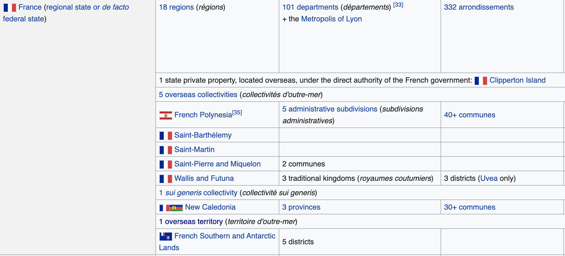

Slide 17
Other subunits
(constituencies)

